Slide 1
Healthcare Persistency of a drug

Slide 2
Info
Group Name: sika (individual)
Name: Mohamed Sayed Hassan
Email: msiika70@gmail.com
Country: Egypt
College: Cairo university, Faculty of computers and artificial intelligence
Specialization: Data Science
Problem Description: gather insights on the factors that are impacting the persistency, build a classification for the given dataset.
Github: https://github.com/mohamedsiika/Persistency-of-the-drug/

Slide 3
Business Understanding:
One of the challenges for all pharmaceutical companies is to understand the persistency of drug as per the physician prescription. To solve this problem ABC pharma company approached an analytics company to automate this process of identification.
Drug persistence: the extent to which a patient acts in accordance with the prescribed interval, and dose of a dosing regimen

Slide 4
Project Lifecycle:
Understanding
Data understanding: discover the data and understands the attributes very well then find the outliers and the null values.
Cleaning the data
remove the unimportant features if there is any and do feature cleansing
Analyze
Analyze the data using EDA to understand the relation between features and the conclusions that I can get from the data
Train a Model
Work on model, It is a classification problem (persistent or not persistent) so I am going to use 3 models 1 Linear model 1 ensemble and 1 for boosting.

Slide 5
1-Understanding The Data
The Dataset is Excel file with size 898 KB .The data consists of 67 features, id of each patient and the target variable. The target variable is the persitency_flag.It has also 3424 observations.
Problems in the Data:
Null values: 0 Null values in all data
Outliers: the data is categorical so I searched about what is called “rare values” it’s the values that is represent less than 1% percent of all the observations I found 9 features that has rare values.
Skewed variables: check if there are variables that has approximately on value.

Slide 6
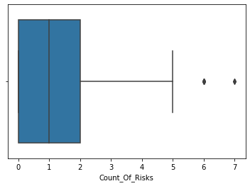
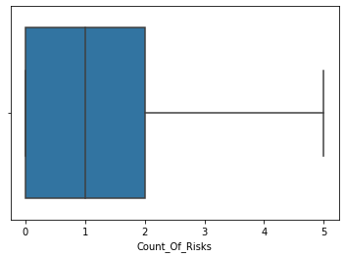
2-cleaning The data
Numerical Features:
Count of Risk : I used the box blot to detect the outliers It appears from the blot
that the observations that has values more than 5 are outliers.
Handling: swap the outliers with the median of the data the median in this case is 1.

Slide 7
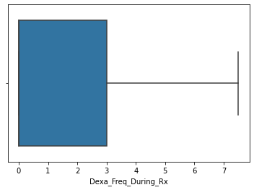
2-CLEANING THE DATA
Dexa freq during Rx :
for "Dexa_Freq_During_Rx" i will use inter quartile range in detecting the outliers
Handling:I will replace values that are higher than the upper bound with the upper bound and the values
lower than lower bound with the lower bound.

Slide 8
2-CLEANING THE DATA
Categorical Features:
substituting the rare values which found by a percentage less than 1 % in each categorical with a default value “Other” to reduce the complexity and the overfitting problem during the training
for i in range(len(df.columns)):
if df.columns[i]!= "Dexa_Freq_During_Rx" or df.columns[i]!= "Count_Of_Risks":
freq=df[df.columns[i]].value_counts(normalize=True)
map=df[df.columns[i]].map(freq)
df[df.columns[i]]=df[df.columns[i]].mask(map<0.01,'other')

Slide 9
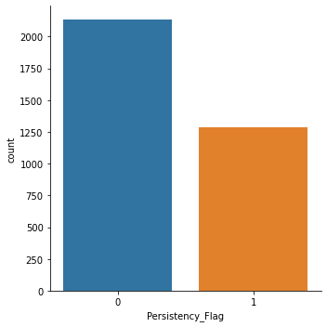
3-Eda Our sample
Most of the patients in our dataset are un-persistent.
We have:
2135 un-persistent patients
1289 persistent patients
That will lead us to a point in our analysis that is normal to found unpersistent patients having a specific feature more than the persistent one so we will look to the features that exists in the persistent patients more than the not persistent

Slide 10
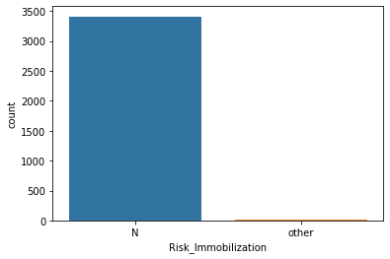
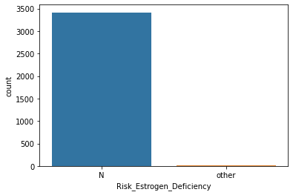
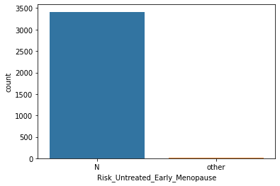
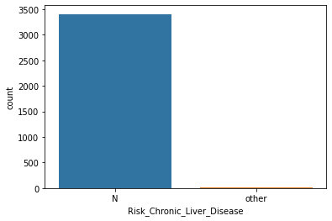
Our sample:
Some features are very skewed to one value and the other value approximatley doesn't exist
Risk_Untreated_Early_Menopause :
3412 have No Risk
12 have Risk
Risk_Chronic_Liver_Disease:
3406 have No Risk
18 have Risk
Risk_Estrogen_Deficiency:
3413 have No Risk
11 have Risk
Risk_Immobilization:
3410 have No Risk
14 have Risk
Risk_Untreated_Chronic_Hyperthyroidism:
3422 Have No Risk
2 have Risk
Risk_Osteogenesis_Imperfecta:
3421 Have No Risk
3 Have Risk

Slide 11
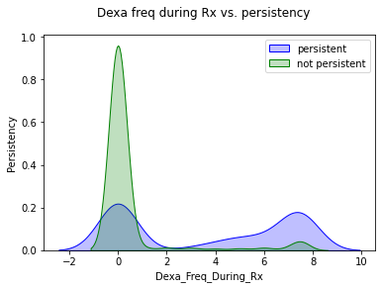
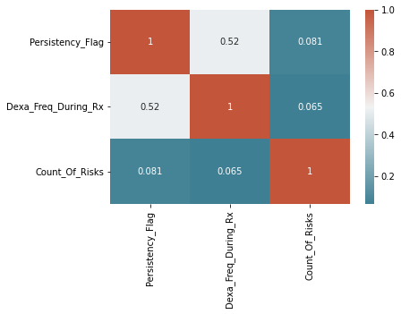
Number of DEXA scans taken prior to the first NTM Rx and the effect on the persistency.

Slide 12
From the last slide we conclude:
There is a positive correlation between Dexa scans and the persistency. When the number of Dexa scans increases the patient tends to be more persistent to the drug.
Most of the not persistent patients have zero Dexa scans taken prior to the first NTM Rx.
.

Slide 13
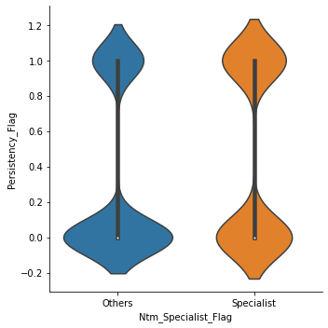
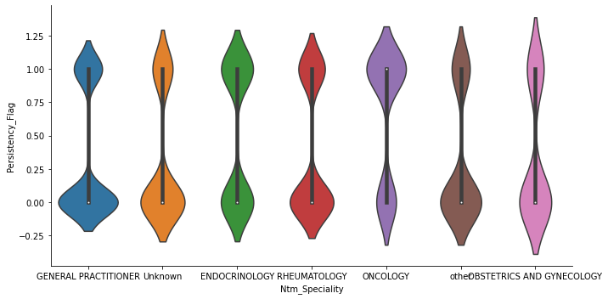
SPeciality of the Hcp who wrote the NTM RX

Slide 14
From the last slide we conclude:
If the HCP who prescribed the NTM RX is a specialist the patient tends to be more persistent.
Non specialists have a large probability to have a non persistent patients . Patients have to take The Ntm Rx from specialsts only
The oncologists have more persistent patients than the other specialists
Oncologists do more dexa scans to their patients and other scans as well also they do more follow ups so that make sense the have more persistent patients.
General practitioners have high percentage of unpersistent patients than the other specialists.

Slide 15
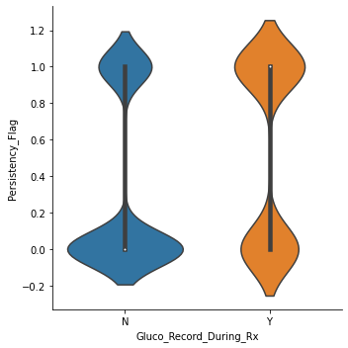
patient had a Glucocorticoid usage during the first continuous therapy and it's relation with persistency flag
From this plot it appears that a large percentage of the patients who hadn't Glucocorticoid during the first continuous therapy are un persistent .
Persistent patients who used Glucocorticoid are more than unpersistent

Slide 16
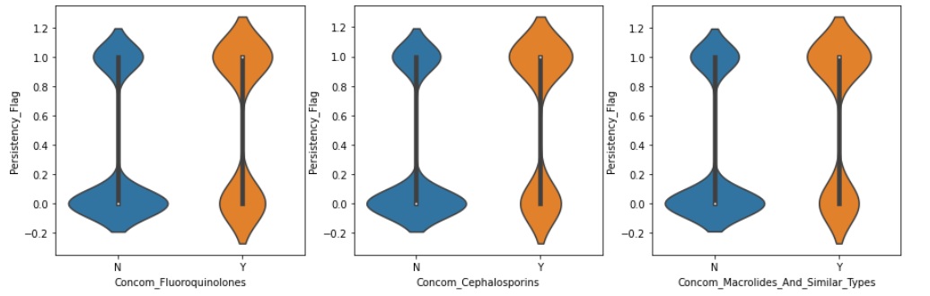
Concomitant drugs recorded prior to starting with a therapy that have good effect on the presitency

Slide 17
From the last slide we conclude:
There are some drugs that affects the persistency
It appears from the last 3 plots that Fluoroquinolones , Cephalosporins ,Macrolides And Similar Types have a postive effect on the persistency.
The patients who hadn't this drugs are less persistent.

Slide 18
Technical conclusion
Dropping the skewed features from the data
The data contains categorical variables so before training the model I have to encode these variables and I will use dummy encoding
I will use 3 models:
Support vector machine
Boosting model I will use Ada Boost and Gradient Boosting classifiers
Linear model I will use Linear regression

Slide 19
4-train a model
Support Vector machine:
the accuracy resulted from this model is 81.89781021897811
I used sklearn SVC to train the model and sk train_test_split to divide the data to test and train samples.
Train sample size is 80 percent from the data

Slide 20
4-Train a model
Boosting models:
Ada Boost Classifier : I adjusted the number of estimators to 250 and the learning rate to 1.
the accuracy of this model is 82.35981308411215.
gradient boosting : I adjusted the number of estimators to 250 and learning rate 0.1
This model accuracy is 81.89252336448598

Slide 21
4-Train a model
Linear Regression :
Used linear_regression from sklearn.linear_models and used train size 7o percent from the whole data
accuracy resulted from it is 80.6420233463035 .
As you see from the resulting accuracies that the models are close from each other with average accuracy 81 %.

